Slide 1
Random Forest

Slide 2
Bias vs Variance
There are 3 types of prediction error: bias, variance, and irreducible error. Irreducible error, also known as "noise," can't be reduced by the choice of algorithm. The other two types of errors, however, can be reduced because they stem from your algorithm choice.
… bias is an error from erroneous assumptions in the learning algorithm. High bias can cause an algorithm to miss the relevant relations between features and target outputs (underfitting)
“… variance is an error from sensitivity to small fluctuations in the training set. High variance can cause an algorithm to model the random noise in the training data, rather than the intended outputs (overfitting).

Slide 3
Bias vs Variance
Symptoms of High Bias
Poor performance on training data
Poor performance on test data
Example: Linear regression used for a highly non-linear banking churn problem
Symptoms of High Variance
Very high training accuracy
Very low test accuracy
Example: A deep decision tree memorizing customer data
Model Type | Bias | Variance
Simple models (Linear, Naive Bayes) | High | Low
Complex models (Deep Trees, kNN small k) | Low | High

Slide 4
Ensemble Learning
Ensemble Learning in machine learning that integrates multiple models called as weak learners to create a single effective model for prediction. This technique is used to enhance accuracy, minimizing variance and removing overfitting
Here, individual classifiers vote and final prediction label returned that performs majority voting.
These models can parallelize by allocating each base learner to different mechanisms.
So, we can say that ensemble learning methods are meta-algorithms that combine several machine learning algorithms into a single predictive model to increase performance.

Slide 5
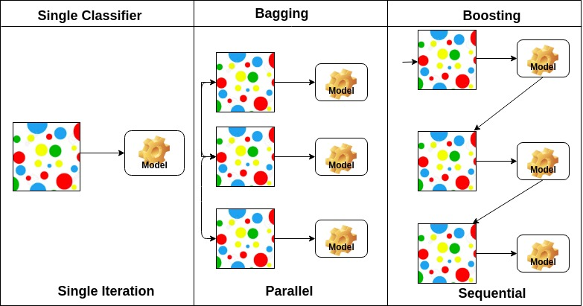
Ensemble Learning

Slide 6
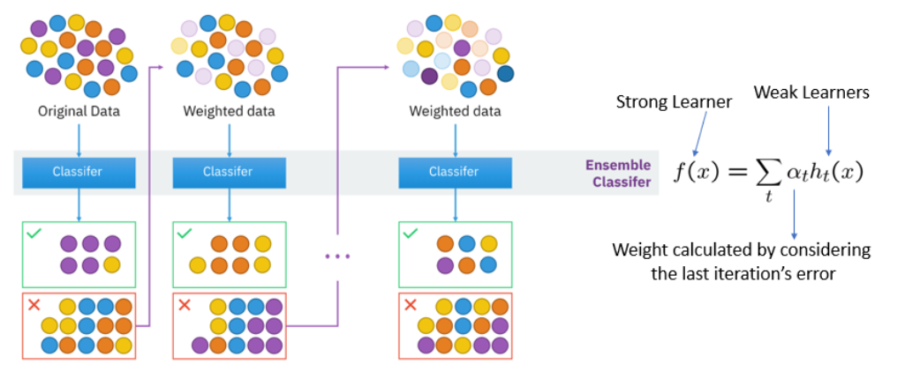
Boosting
Image source: https://www.pluralsight.com/guides/ensemble-methods:-bagging-versus-boosting

Slide 7
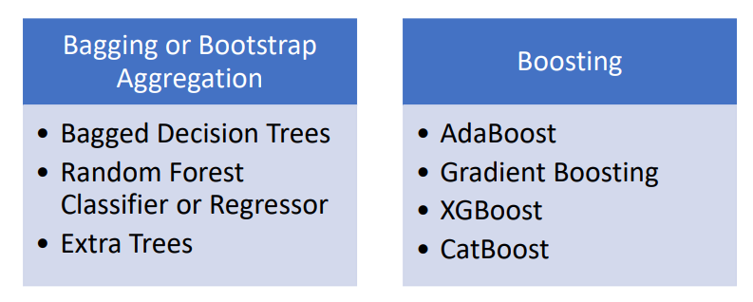
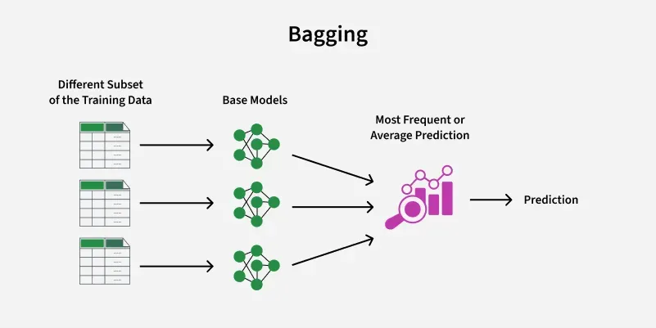

Slide 8
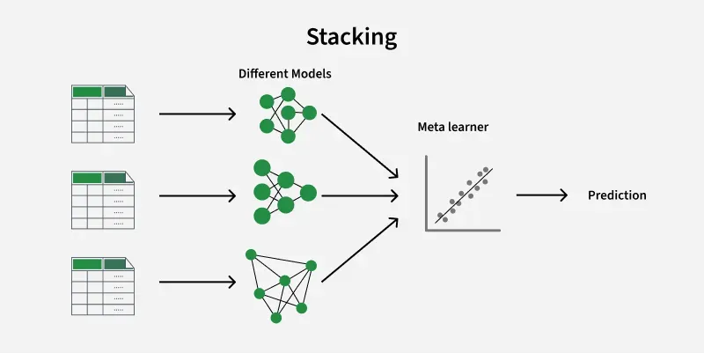
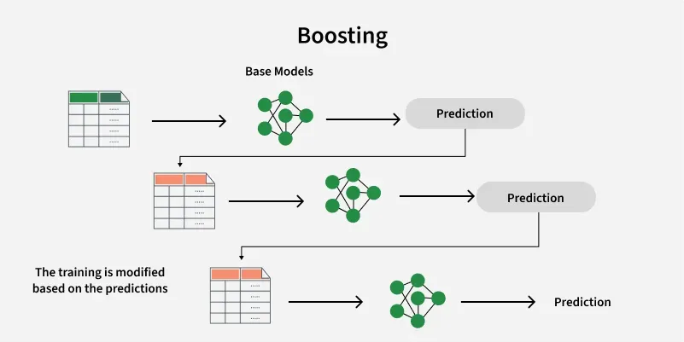

Slide 9
Bagging (Bootstrap Aggregating)
Bagging is a technique that involves creating multiple versions of a model and combining their outputs to improve overall performance.
In bagging several base models are trained on different subsets of the training data, then aggregate their predictions to make the final decision.
The subsets of the data are created using bootstrapping, a statistical technique where samples are drawn with replacement, meaning some data points can appear more than once in a subset.
The final prediction from the ensemble is typically made by either:
Averaging the predictions (for regression problems), or
Majority voting (for classification problems).
This approach helps to reduce variance, especially with models that are prone to overfitting, such as decision trees.

Slide 10
Common Algorithms Using Bagging
1. Random Forest
Random forest is an ensemble method based on decision trees. Multiple decision trees are trained using different bootstrapped samples of the data.
In addition to bagging, Random Forest also introduces randomness by selecting a random subset of features at each node, further reducing variance and overfitting.
2. Bagged Decision Trees
In Bagged Decision Trees, multiple decision trees are trained using bootstrapped samples of the data.
Each tree is trained independently and the final prediction is made by averaging the predictions of all the trees in the ensemble.

Slide 11
Boosting
Boosting is an ensemble technique where multiple models are trained sequentially, with each new model attempting to correct the errors made by the previous ones.
Boosting focuses on adjusting the weights of incorrectly classified data points, so the next model pays more attention to those difficult cases. By combining the outputs of these models, boosting typically improves the accuracy of the final prediction.
The final prediction from the ensemble is typically made by:
Weighted sum (for regression problems), or
Weighted majority vote (for classification problems).
This approach helps to reduce bias, especially when using weak learners, by focusing on the misclassified points.

Slide 12
Common Algorithms Using Boosting
1. AdaBoost (Adaptive Boosting)
AdaBoost works by adjusting the weights of misclassified instances and combining the predictions of weak learners (usually decision trees). Each subsequent model is trained to correct the mistakes of the previous model.
AdaBoost can significantly improve the performance of weak models, especially when used for classification problems.
2. Gradient Boosting
Gradient Boosting is a more general approach to boosting that builds models sequentially, with each new model fitting the residual errors of the previous model.
The models are trained to minimize a loss function, which can be customized based on the specific task.
We can perform regression and classification tasks using Gradient Boosting.
3. XGBoost (Extreme Gradient Boosting)
XGBoost is an optimized version of gradient boosting. It includes regularization to prevent overfitting and supports parallelization to speed up training.
XGBoost has become a popular choice in machine learning competitions due to its high performance.

Slide 13
Stacking
Stacking (Stacked Generalization) combines multiple models (base learners) of different types, where each model makes independent predictions and a meta-model is trained to combine these predictions.
Instead of simply averaging or voting, as in bagging and boosting, stacking trains a higher-level model (meta-model) to learn how to best combine the predictions of the base models.
In stacking, the base models are trained on the original data and their predictions are then used as features for the meta-model, which learns how to combine them effectively. The final prediction is made by the meta-model based on the combined outputs of all the base models.

Slide 14
Common Algorithms Using Stacking
1. Generalized Stacking
In Generalized Stacking, multiple different models (e.g., decision trees, logistic regression, neural networks) are trained on the same dataset.
And a meta-model (such as a logistic regression or another decision tree) is trained on the predictions made by the base models.
The meta-model learns how to combine the predictions of the base models to make the final prediction.
2. Stacking with Cross-Validation
In stacking with cross-validation, the base models are trained using cross-validation and their predictions on the validation set are used to train the meta-model.
This prevents overfitting and ensures that the meta-model is trained on unbiased data.
3. Multi-Layer Stacking
Multi-layer stacking involves multiple levels of base models, where the outputs of the first level of models are fed into a second level of base models and so on, before reaching the meta-model.
This approach creates a more complex ensemble that can capture a wider variety of patterns in the data.

Slide 15
Random Forest Classifier
{
{
The subsets of variables are selected at random to build a decision tree
Forest of
“Decision” trees

Slide 16
Random Forest
Random Forest is a commonly used model that can solve both classification and regression problems.
A random forest is made up of many decision trees that are trained using bagging. Its outcome is determined by taking the average of the prediction of individual trees.
The node size, the number of trees, and number of features sampled are the three main hyperparameters that need to be set before training the random forest.
What about randomness in a random forest?
Feature bagging, also known as feature randomness, creates a random sample of features to ensure low correlation among decision trees.
This approach sets apart random forests from decision trees which consider all the possible feature splits, whereas random forests consider only a subset of those features.

Slide 17
Introduction
Random Forests can be regarded as ensemble learning with decision trees
  Instead of building a single decision tree and use it to make predictions, build many slightly different trees
  Combine their predictions using majority voting
The main two concepts behind random forests are:
  The wisdom of the crowd — a large group of experts are collectively smarter than individual experts
  Diversification — a set of uncorrelated tress
A supervised machine learning algorithm
  Classification (predicts a discrete-valued output, i.e. a class)
  Regression (predicts a continuous-valued output) tasks.

Slide 18
Random Forest
Random Forest consists of several independent decision trees that operate as an ensemble
It is an ensemble learning algorithm based on bagging
Train decision tree models on bootstrap samples where variables are selected at random. The aggregate output from these tree is considered as the final output

Slide 19
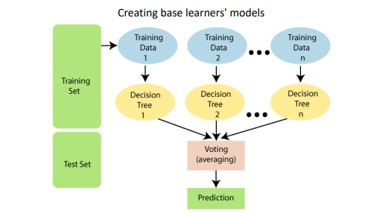
Random Forest
Random Forest is a classifier that contains several decision trees on various subsets of the given dataset and takes the average to improve the predictive accuracy of that dataset.
Instead of relying on one decision tree, the random forest takes the prediction from each tree and based on the majority votes of predictions, and it predicts the final output.
The greater number of trees in the forest leads to higher accuracy and prevents the problem of overfitting.

Slide 20
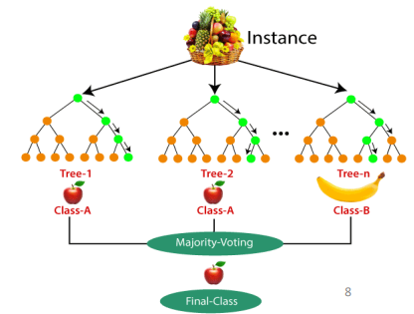
Random Forest
Steps involved in random forest algorithm:
Step 1: In Random forest n number of random records are taken from the data set having k number of records.
Step 2: Individual decision trees are constructed for each sample.
Step 3: Each decision tree will generate an output.
Step 4: Final output is considered based on Majority Voting or Averaging for Classification and regression respectively.

Slide 21
When to Use Random Forests (and When Not To)
Random Forests are a great choice when you need a strong baseline model that works well out of the box. They handle both numerical and categorical features, manage missing values gracefully, and are less prone to overfitting than single decision trees.
Use Random Forests when:
You have tabular data with mixed feature types
You want a robust model without heavy feature scaling or preprocessing
Interpretability (via feature importance) matters for your application
However, Random Forests may not be ideal when:
You need real-time predictions; they can be slower than single models
You’re dealing with very high-dimensional data (e.g., text or images)
You want state-of-the-art accuracy on structured data, where gradient boosting methods like XGBoost or LightGBM often outperform them

Slide 22
Random Forests Algorithm
For b = 1 to B:
(a) Draw a bootstrap sample Z∗ of size N from the training data.
(b) Grow a random-forest tree to the bootstrapped data, by recursively repeating the following steps for each terminal node of the tree, until the minimum node size n_{min} is reached.
i. Select m variables at random from the p variables.
ii. Pick the best variable/split-point among the m.
iii. Split the node into two daughter nodes.
To make a prediction at a new point x we do:
For regression: average the results
For classification: majority vote
Output the ensemble of trees.

Slide 23
Why a Random Forest?
Accurate predictions
  Standard decision trees often have high variance and low bias
  High chance of overfitting (with ‘deep trees’, many nodes)
  With a Random Forest, the bias remains low and the variance is reduced
  thus we decrease the chances of overfitting
Flexible
  Can be used with many features
  Can be used for classification but also for regression
Disadvantages:
  When the number of variables is large, but the fraction of relevant variables is small, random forests are likely to perform poorly when m is small

Slide 24
Aggregation
Model predictions undergo aggregation to combine them for the final prediction to consider all the possible outcomes.
The aggregation can be done based on the total number of outcomes or the probability of predictions derived from the bootstrapping of every model in the procedure.

Slide 25
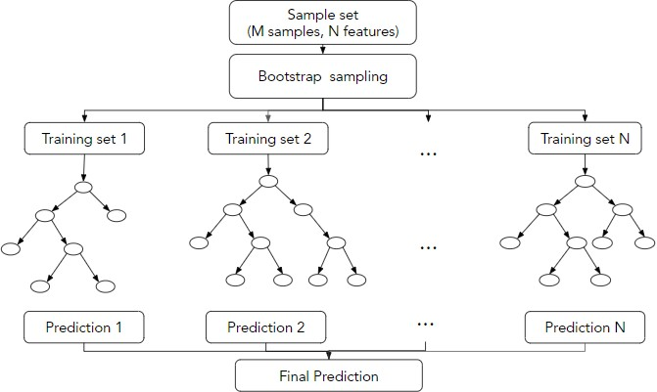
Steps for prediction using random forest
For classification, the final prediction considers the mode of the predicted labels and for regression, it considers the average of the predicted values.

Slide 26
Feature importance in random forest
A technique that assigns a score to independent features based on its importance in predicting the target variable
These scores indicates the relative importance of the features
Two techniques that are used to find the feature importance in random forest:
  Gini importance
  Mean decrease in accuracy

Slide 27
Gini importance
Also known as mean decrease impurity
It is the average total decrease in the node impurity weighted by the probability of reaching it
The average is taken over all the trees in the random forest
The sklearn library in python considers this measure
‘rf_model.feature_importances_’ returns the feature importance for each variable

Slide 28
Mean decrease in accuracy
In machine learning, feature selection means finding which input variables are most useful for making predictions.
When a Random Forest model is trained, it builds many decision trees using different samples of the data. For each tree, some data points are left out; these are called out-of-bag (OOB) samples and are used to estimate prediction error.
To measure how important a feature is:
The model first calculates the OOB error normally.
Then, the values of one feature are shuffled (permuted) randomly.
The OOB error is calculated again.
If the error increases a lot, that feature is important.
If the error barely changes, the feature is less useful.
Features that cause a large increase in error after permutation are ranked as more important. We can keep these important features and remove the less useful ones to build a simpler and better model.Application: Utilized for enhancing model interpretability and efficiency, by focusing on the most influential predictors.

Slide 29
Advantages of Random Forest:
Improved Accuracy - Random Forest often achieve higher accuracy compared to individual models.
Increased Robustness - Random Forest more robust to outliers and noisy data.
Reduced Variance - Random Forests reduce variance by taking many trees from n bootstrapped samples and averaging their prediction leading to lower variance.

Slide 30
Advantages of Random Forest:
Reduced Bias -
  Random Forests reduce bias in the dataset by decorrelating the trees which is a problem with imbalanced datasets Random forests overcome this problem by forcing each split to consider only a subset of the predictors.
  p - Total number of predictors in dataset.
  m - Number of predictors considered at each split.
  Therefore, on average (p − m)/p of the splits random Forests enhance model diversity and reduce over-reliance on dominant predictors by randomly selecting a subset of features for each split, allowing lesser-known features to play a more significant role in the decision-making process. We can think of this process as decorrelating the trees, thereby making the average of the resulting trees less variable and hence more reliable

Slide 31
Disadvantages of Random Forest:
Increased Complexity - Ensembles introduce additional complexity to the modeling process.
Computational Overhead - Ensemble methods require training and maintaining multiple models, which can be computationally expensive, especially when dealing with large datasets or complex models.
Interpretability - Ensemble models are typically less interpretable compared to individual models.

Slide 32
Disadvantages of Random Forest:
Dependency on Individual Models - The performance of ensemble methods heavily relies on the diversity and quality of individual models.
Training Data Requirements - Ensembles require a sufficient amount of training data to train and validate multiple models effectively.

Slide 33
Steps to decide ensemble method for a ML tasks
Ensemble methods work well with large datasets
Evaluate Baseline Models - If base models able to give good results then going for ensemble methods might not be necessary.
Training resources - Ensembles can be computationally expensive, especially if you plan to train multiple large models. Consider the training time, memory requirements, and available hardware.
Evaluate Interpretability Needs - Determine the importance of interpretability in your task. If the interpretability of individual model predictions is crucial for decision-making or regulatory compliance, ensembles might be less suitable.
Consider Performance Improvement - Assess the potential for performance improvement with ensemble techniques.
  If the baseline models are underperforming or show high variance, an ensemble may help reduce bias and variance, leading to better overall prediction

Slide 34
What is the main idea behind bagging in ensemble learning?
Training models sequentially to correct errorsB
Training multiple models on different subsets of data and averaging predictions
Using deep learning models for classification
Selecting only the best-performing model

Slide 35
How does boosting differ from bagging?
Boosting focuses on training multiple weak models sequentially
Boosting trains independent models in parallel
Boosting does not use weighted samples
Boosting is only used for regression problems

Slide 36
Which of the following is an example of a bagging algorithm?
AdaBoost
Random Forest
Gradient Boosting
XGBoost

Slide 37
What is the main purpose of stacking in ensemble learning?
To train multiple models and average their outputs
To train multiple models and use another model to combine their predictions
To train a single powerful model
To select the best-performing model and discard others

Slide 38
Which of the following ensemble learning methods is known for reducing bias?
Bagging
Boosting
Stacking
K-Means

